Slide 1
Control Engineering
Lecture 5+6

Slide 2
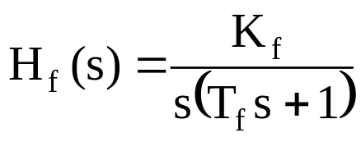

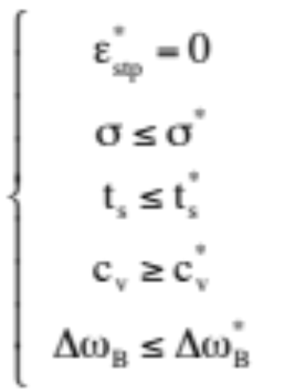
Frequency design methods
Design of P/PI/PD/PID controllers based on frequency response of the open loop system
Performance criteria set:

Slide 3
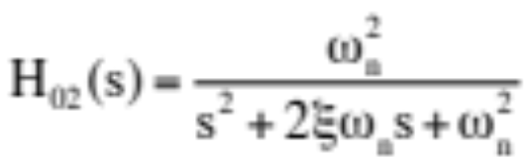
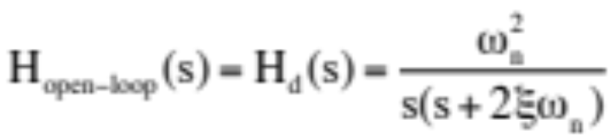

Frequency design methods
There is an equivalence between time and frequency response performance measures, provided that the closed loop system is:
Bode open loop system magnitude diagram can be used to estimate
closed loop performance

Slide 4
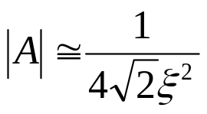
Frequency design methods
Design of a P controller:
M^{dB}
Start from overshoot σ, determine ξ, determine A_{dB}
-20
c_{v}
ω_{t}
ω_{f}
|A|
1
10
N
ω
F
-40
|H_{d}|
|H_{f}|

Slide 5



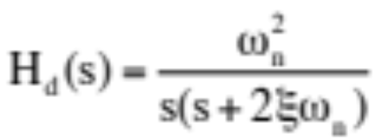
Frequency design methods
Design of a P controller
M^{dB}
If FN, then
If FN, then
-20
c_{v}
ω_{t}
ω_{f}
|A|
1
10
N
ω
F
-40
|H_{d}|
|H_{f}|

Slide 6
Frequency design methods
Design of a P controller:
      what about the remaining performance specifications?
M^{dB}
-20
c_{v}
ω_{t}
ω_{f}
|A|
1
10
N
ω
F
-40
|H_{d}|
|H_{f}|

Slide 7
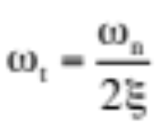
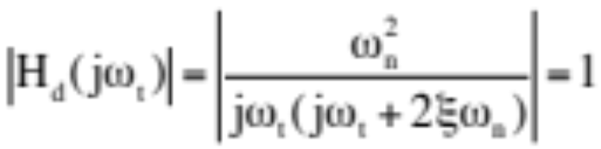
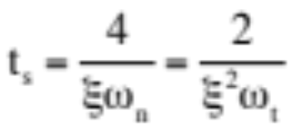
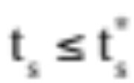
Frequency design methods
Design of a P controller:
      what about the remaining performance specifications?
✔
      Determined from the modulus condition
✔
      Read ω_{t} from Bode diagram
      Compute settling time
      Check that
      Settling time requirement is achieved indirectly! Iterative procedure based on modifying ξ starting from a different σ value

Slide 8
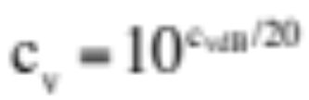
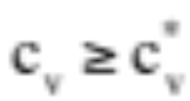
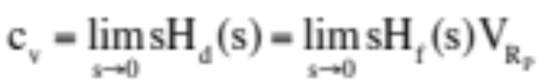
Frequency design methods
Design of a P controller:
      what about the remaining performance specifications?
✔
      c_{v} is determined from the modulus diagram at ω=1
      Read c_{v} from Bode diagram
      Compute
      Check that
✔
✔
      Analytical approach:
      Velocity error constant requirement is achieved indirectly! Iterative procedure based on modifying ξ starting from a different σ value

Slide 9


Frequency design methods
Design of a P controller:
      what about the remaining performance specifications?
✔
      Read ω_{t} from Bode diagram
      Assume
      Check that
✔
✔
✔
✔
      Closed loop bandwidth requirement is achieved indirectly! Iterative procedure based on modifying ξ starting from a different σ value

Slide 10
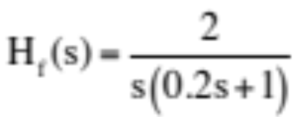
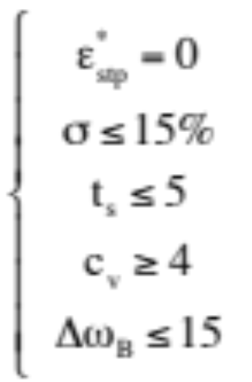
Example
Design a controller for the DC motor with the transfer function
to obtain the following performance specification set

Slide 11
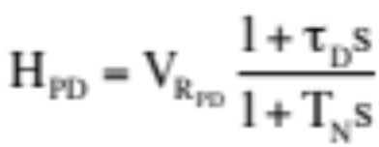
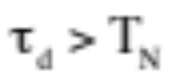
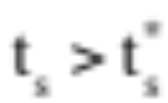
Frequency design methods
Design of a PD controller
M^{dB}
When do we need a PD controller???
When the designed P controller has a settling time larger than the imposed value
-20
c_{v}
ω_{t}
ω_{f}
|A|
10
ω
Due to the fact that the designed H_{dP}(s) has a small cutting frequency ω_{t}
1
N
F
-40
|H_{d}|
|H_{f}|

Slide 12
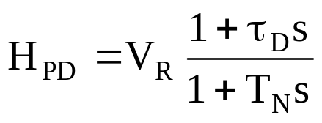
Frequency design methods
Design of a PD controller
M^{dB}
Solution:
Increase ω_{t} =ω_{t1} such that the new cutting frequency ω_{t2} is larger
-20
c_{v}
ω_{t}
ω_{f}
Shift Bode diagram to the right
|A|
1
10
N
ω
F
-40
|H_{d}|
|H_{f}|
By how much?

Slide 13
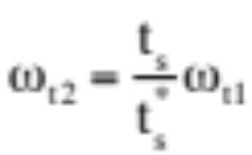


Frequency design methods
Design of a PD controller
M^{dB}
New cutting frequency ω_{t2} should be:
Simply choose:
-20
To compensate for the large process time constant
c_{v}
ω_{t1}
ω_{t2}
|A|
1
10
M
ω
N
F
-40
|H_{d2}|
With P only controller:
|H_{d1}|
|H_{f}|

Slide 14
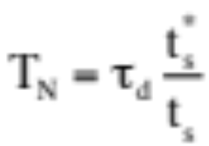
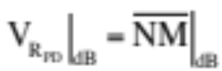
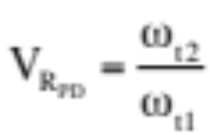
Frequency design methods
Design of a PD controller
M^{dB}
How much should T_{N} be such that t_{s} decreases?
-20
c_{v}
Determine the PD controller gain:
ω_{t1}
ω_{t2}
|A|
1
10
M
ω
N
F
-40
|H_{d2}|
Analytically:
|H_{d1}|
|H_{f}|

Slide 15
Frequency design methods
Design of a PD controller
      what about the remaining performance specifications?
M^{dB}
✔
✔
-20
c_{v}
✔
ω_{t1}
ω_{t2}
|A|
1
10
M
ω
N
F
-40
|H_{d2}|
|H_{d1}|
|H_{f}|

Slide 16
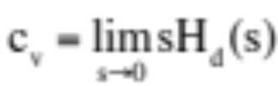
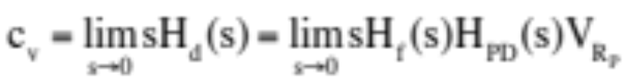
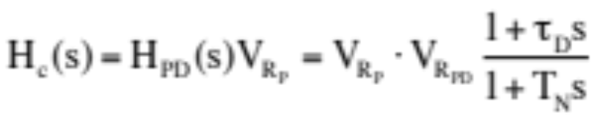
Frequency design methods
Design of a PD controller
      what about the remaining performance specifications?
✔
      c_{v} is determined from the modulus diagram at ω=1
✔
      Compute
      Check that
      Read c_{v} from Bode diagram
✔
      Analytical approach:
      The open loop (forward) transfer function contains the fixed part, the P controller previously designed and the PD controller:
      The new controller is:

Slide 17

Frequency design methods
Design of a PD controller
      what about the remaining performance specifications?
✔
✔
      Assume
      Check that
      Read ω_{t2}from Bode diagram
✔
✔
✔

Slide 18
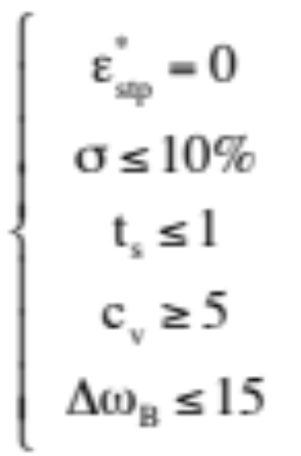
Example
Design a controller for the DC motor with the transfer function
to obtain the following performance specification set

Slide 19
Design of a PD controller
Why?

Slide 20
Design of a PD controller
Why?
The P controller already designed does not meet the t_{s} requirement

Slide 21
Design of a PI controller
Why?

Slide 22
Design of a PI controller
Why?
The P controller already designed does not meet the c_{v} requirement

Slide 23
Frequency design methods
Design of a P controller:
M^{dB}
Start from overshoot σ, determine ξ, determine A_{dB}
-20
c_{v}
ω_{t}
ω_{f}
|A|
1
10
N
ω
F
-40
|H_{d}|
|H_{f}|

Slide 24
Frequency design methods
Design of a P controller
M^{dB}
If FN, then
If FN, then
-20
c_{v}
ω_{t}
ω_{f}
|A|
1
10
N
ω
F
-40
|H_{d}|
|H_{f}|

Slide 25
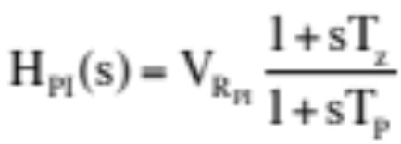
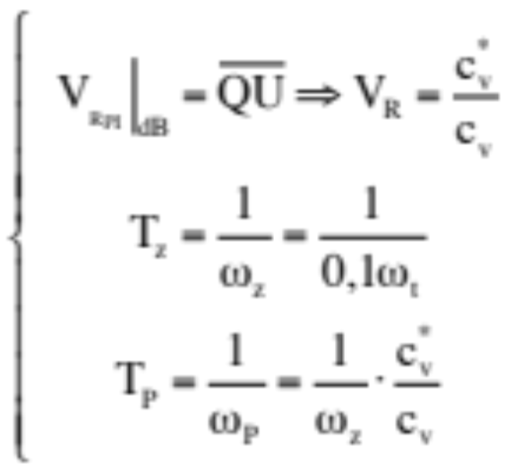
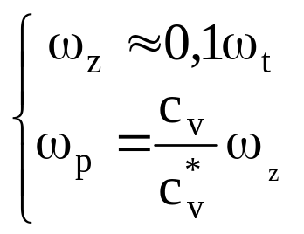
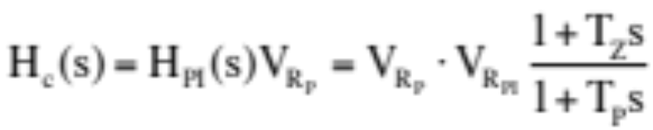
Frequency design methods
Design of a PI controller
M^{dB}
-20
|H_{dC}|
U
Q
-40
c_{v}
ω_{t}
-20
ω_{f}
|A|
1
ω_{p}
ω_{z}
10
N
ω
      The new controller is:
F
-40
|H_{f}|
|H_{d}|

Slide 26
Frequency design methods
Design of a PI controller
      what about the remaining performance specifications?
M^{dB}
-20
|H_{dC}|
✔
U
Q
-40
✔
✔
c_{v}
ω_{t}
-20
ω_{f}
✔
|A|
1
ω_{p}
ω_{z}
10
N
ω
✔
F
-40
|H_{f}|
|H_{d}|

Slide 27
Frequency design methods
Design of a PI controller
      what about the remaining performance specifications?
M^{dB}
-20
|H_{dC}|
✔
U
Q
-40
✔
?
c_{v}
ω_{t}
-20
ω_{f}
✔
|A|
1
ω_{p}
ω_{z}
10
N
ω
✔
F
-40
|H_{f}|
|H_{d}|

Slide 28

Frequency design methods
Design of a PI controller
      what about the remaining performance specifications?
M^{dB}
-20
|H_{dC}|
✔
U
Q
-40
✔
?
c_{v}
ω_{t}
-20
ω_{f}
✔
|A|
1
ω_{p}
ω_{z}
10
N
ω
✔
F
-40
      The actual closed loop system is similar with the one from GT with correction:
|H_{f}|
|H_{d}|

Slide 29
Frequency design methods
Design of a PID controller:
M^{dB}
      Design a P controller
      Design a PD controller
      Design a PI controller
-20
|H_{d2}|
D
E
-40
c_{v}
ω_{t}
-20
ω_{f}
1
ω_{p}
ω_{z}
10
M
ω
|A|
N
F
-40
|H_{dC}|
|H_{f}|
|H_{d1}|

Slide 30
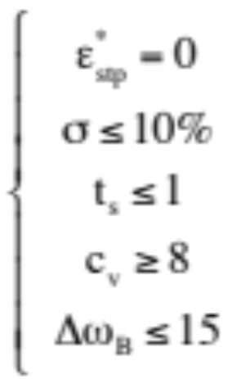
Example
Design a controller for the DC motor with the transfer function
to obtain the following performance specification set

